Slide 1



OCTOBER 2026
HELLO,
I’M
AJAY
LOHANI
B.Com 2nd semester
Kumaun University
Skills: Excel | Power Query | Power BI
Projects : power query | hyperlink | power bi | pivot table

Slide 2

ABOUT ME
I ‘M
AJAY LOHANI
I am a b.com student with an interest in business, data analysis, and technology. I enjoy learning new skills and improving my knowledge to build a successful career
EDUCATION : B.COM 2ND SEMESTER STUDENT
SKILLS : MICROSOFT EXCEL, POWER QUERY & POWER BI
HOBBIES :ANIME, GAMING AND LEARNING NEW SKILLS
CAREER GOAL : TO BECOME A SKILLED DATA ANALYST AND BUILD A SUCCESFUL CAREER

Slide 3

PROJECTS
PROJECT 1 : SALES DATA ANALYSIS
Analyzed 3 years of shop sales data
Summarized sales by category and product.
Identified stop – performing products.
PROJECT LINK : VIEW PROJECT
PROJECT 2 : EMPLOYEE DATA ANALYSIS
Organized employee records
Summarized department-wise employee data.
Compared employee information using pivot tables
PROJECT LINK : VIEW PROJECT

Slide 4
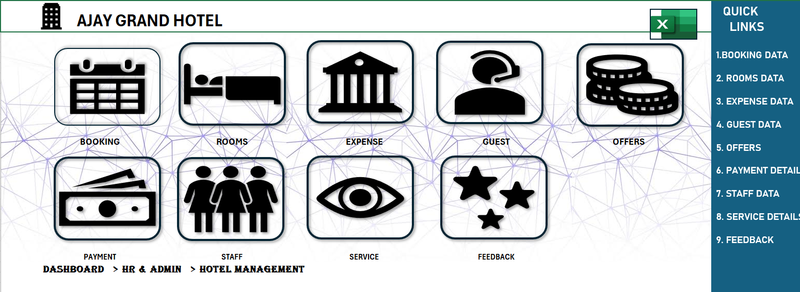
PROJECTS
PROJECT 1 : AJAY GRAND HOTEL
Developed on excel-based hotel management dashboard.
Managed booking and room details.
Organized guest, staff and expense data.
Included payment, offer and feedback sections.
PROJECT LINK : VIEW PROJECT

Slide 5
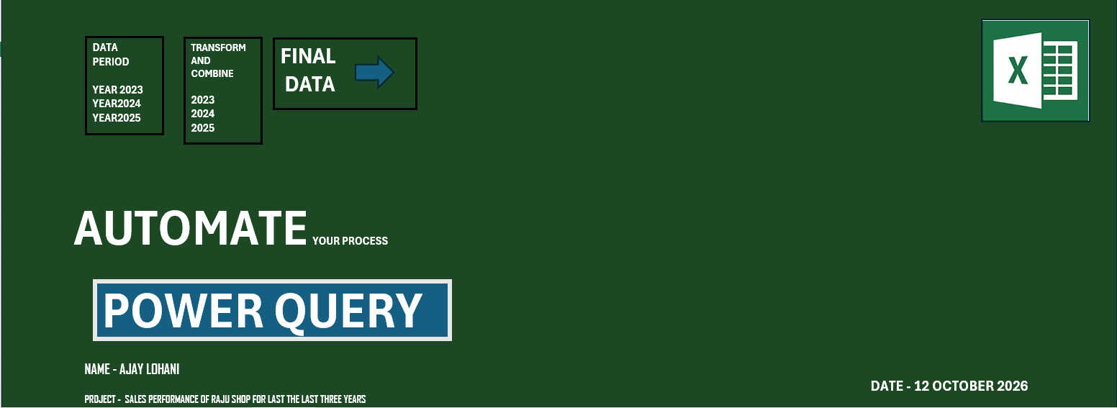
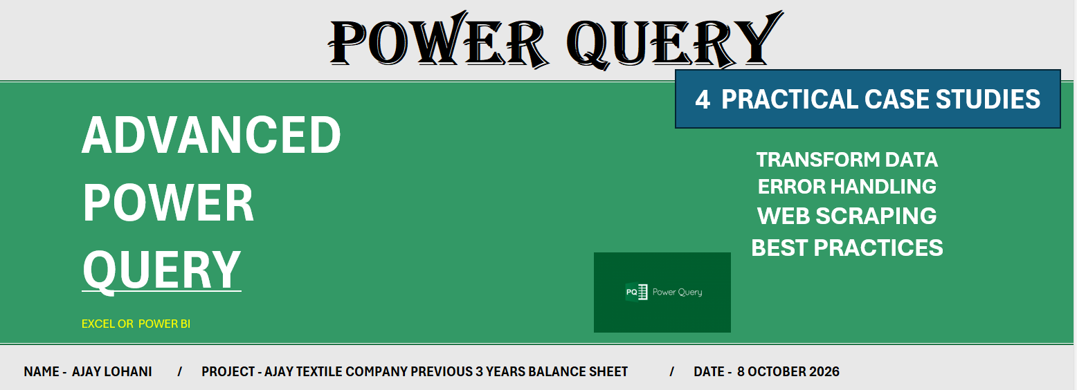
PROJECTS
PROJECT 1 : SALES PERFORMANCE OF SAJU SHOP FOR LAST THREE YEARS
ANALYZED 3 YEARS OF SHOP SALES DATA.
EVALUTED SALES PERFORMANCE AND TRENDS.
IDENTIFIED TOP PERFORMING PRODUCTS.
PROJECT LINK : VIEW PROJECT
PROJECT 2 : TEXTILE COMPANY PREVIOUS 3 YEARS BALANCE SHEET DATA
Learned to automate repetitive data tasks.
Explored data cleaning and transformation.
PROJECT LINK : VIEW PROJECT

Slide 6
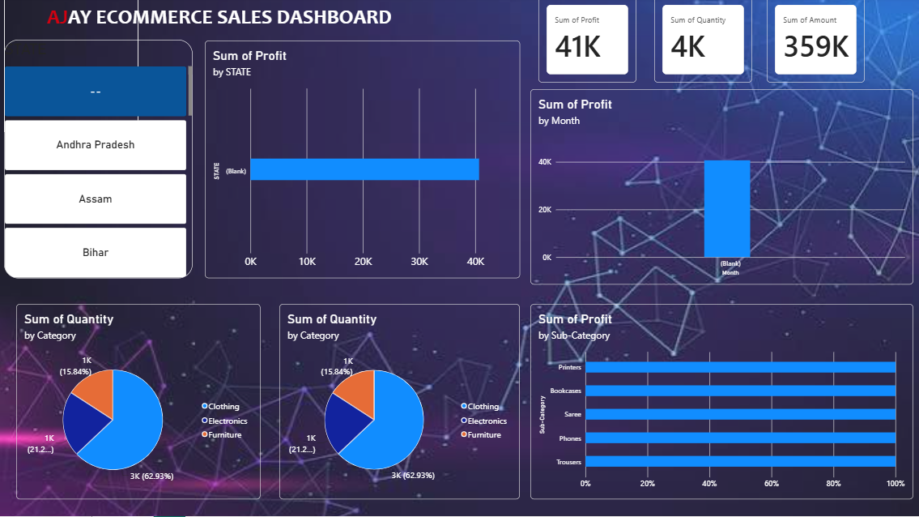
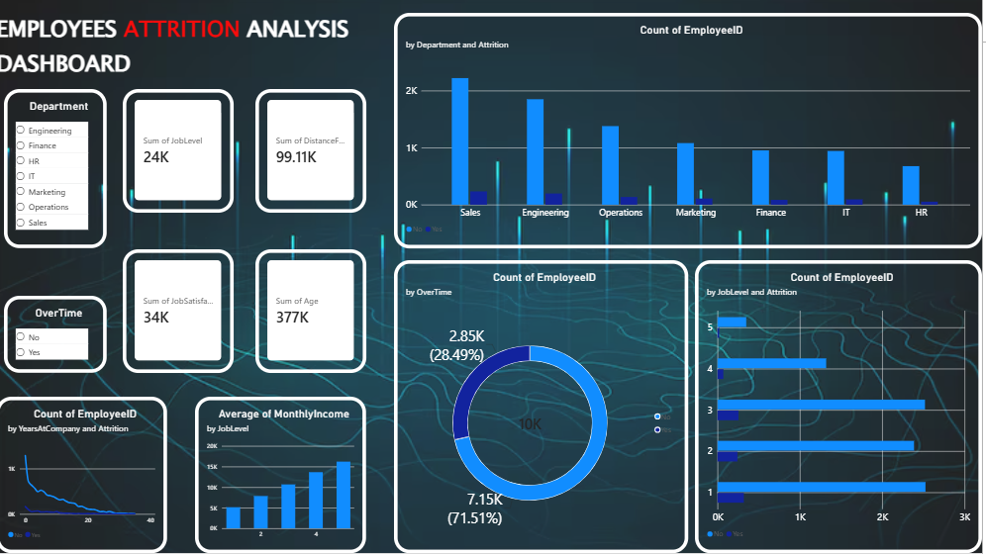
PROJECTS
Project 1 : ecommerce sales dashboard
Analyzed e-commerce sales and business performance.
Visualized sales, profit and product trends using charts.
PROJECT LINK : VIEW PROJECT
PROJECT 2: EMPLOYEES ATTRIBUTION ANALYSIS
Analyzed employee attrition and workforce trends.
Created charts and kpis to identify employee turnover
PROJECT LINK : VIEW PROJECT

